Slide 1

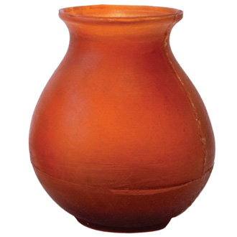
Recursion

Slide 2
How do you empty a vase containing five flowers?
How do you empty a vase containing five flowers?
Answer: if the vase is not empty, you take out one flower and then you empty a vase containing four flowers.
How do you empty a vase containing four flowers?
Answer: if the vase is not empty, you take out one flower and then you empty a vase containing three flowers.
How do you empty a vase containing three flowers?
Answer: if the vase is not empty, you take out one flower and then you empty a vase containing two flowers.
How do you empty a vase containing two flowers?
Answer: if the vase is not empty, you take out one flower and then you empty a vase containing one flower.
How do you empty a vase containing one flower?
Answer: if the vase is not empty, you take out one flower and then you empty a vase containing no flowers.
How do you empty a vase containing no flowers?
Answer: if the vase is not empty, you take out one flower but the vase is empty so you're done.
That's repetitive. Let's generalize it:

Slide 3
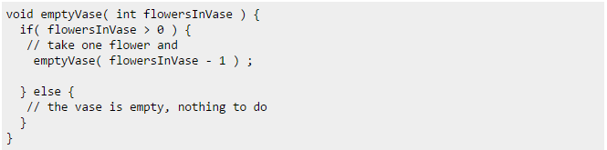
Let's generalize it
How do you empty a vase containing N flowers?
Answer: if the vase is not empty, you take out one flower and then you empty a vase containing N-1 flowers.
Hmm, can we see that in pseudo code?

